Slide 1
Learning technologies in the 21st century
based on the materials of
Microsoft
International Faculty Development Workshop
“Technology Enriched Instruction”

Slide 2
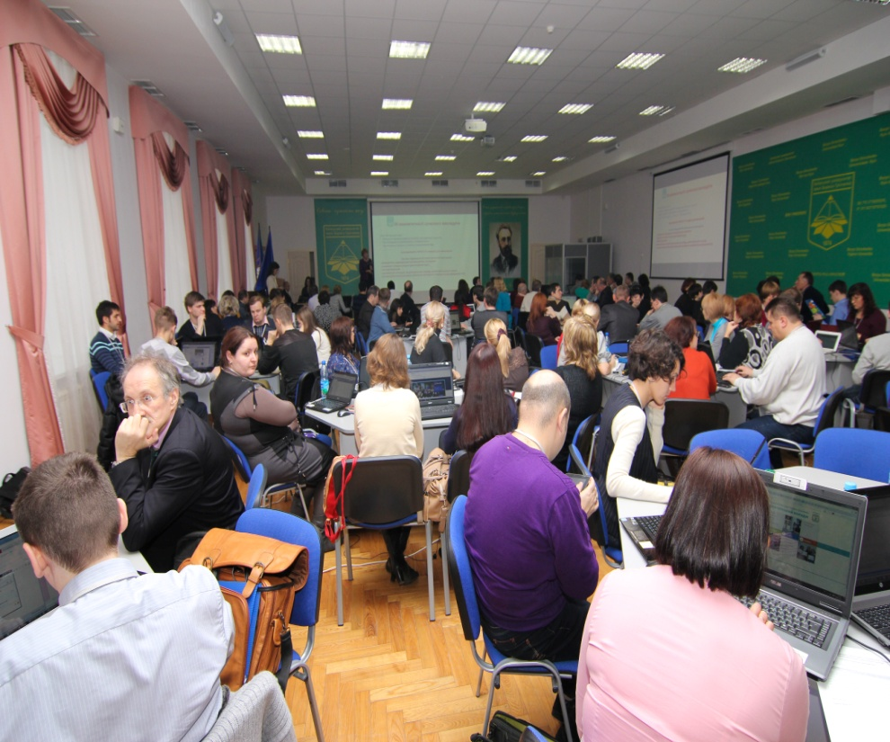
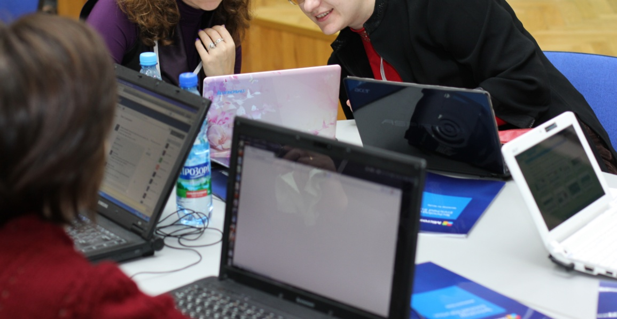
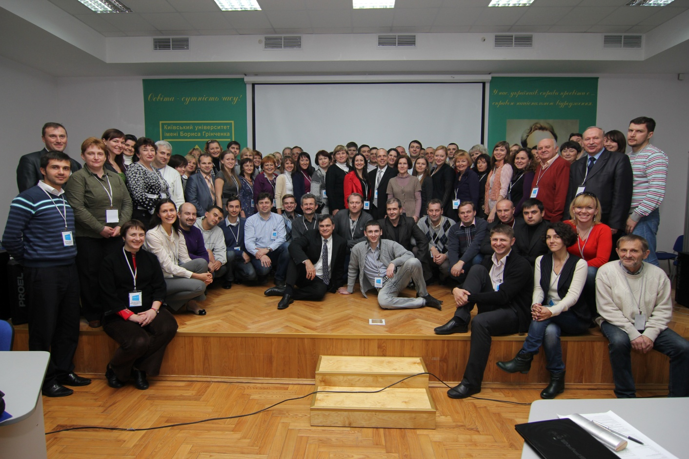

Slide 3
20th Century Skills vs. 21st Century Skills
20th Century Skills and Competences | 21st Century Skills and Competences

Slide 4
21st century skills*
collaboration
knowledge construction
self-regulation
real-world problem-solving and innovation
the use of ICT for learning
skilled communication
*developed and tested internationally for the Innovative Teaching and Learning (ITL) Research project

Slide 6
TECHNOLOGY
Yammer
Padlet
OneNote
PowerPoint
Websearch
Word
Movie Maker
Excel
Skype
Wiki
Your suggestion?

Slide 7
PEDAGOGY
Research
Note taking
Creating a model
Demonstration
Case study
Writing a report
Presentation
Discussion
Interview

Slide 8
http://padlet.com/

Slide 9
http://padlet.com/wall/FIT-13

Slide 10
www.pil-tei.com
www.yammer.com
padlet.com
im.nmu.org.ua

